Slide 1


An AI Chatbot for Water Conservation and Sanitation Education
Hustle Squad

Slide 2

PROBLEM STATEMENT
Developing a chatbot to educate communities about water conservation techniques and best practices for maintaining clean water. The chatbot will answer questions about water-saving methods, provide tips for reducing water usage, and raise awareness about the importance of sanitation.

Slide 3
Why did we choose it?
01
Why this SDG?
Clean water and sanitation are essential for human health and well-being. Many communities lack access to clean water and proper sanitation, leading to various health issues and environmental problems.
02
Importance
Raising awareness and educating people about water conservation can help ensure sustainable water use and improve sanitation practices

Slide 4
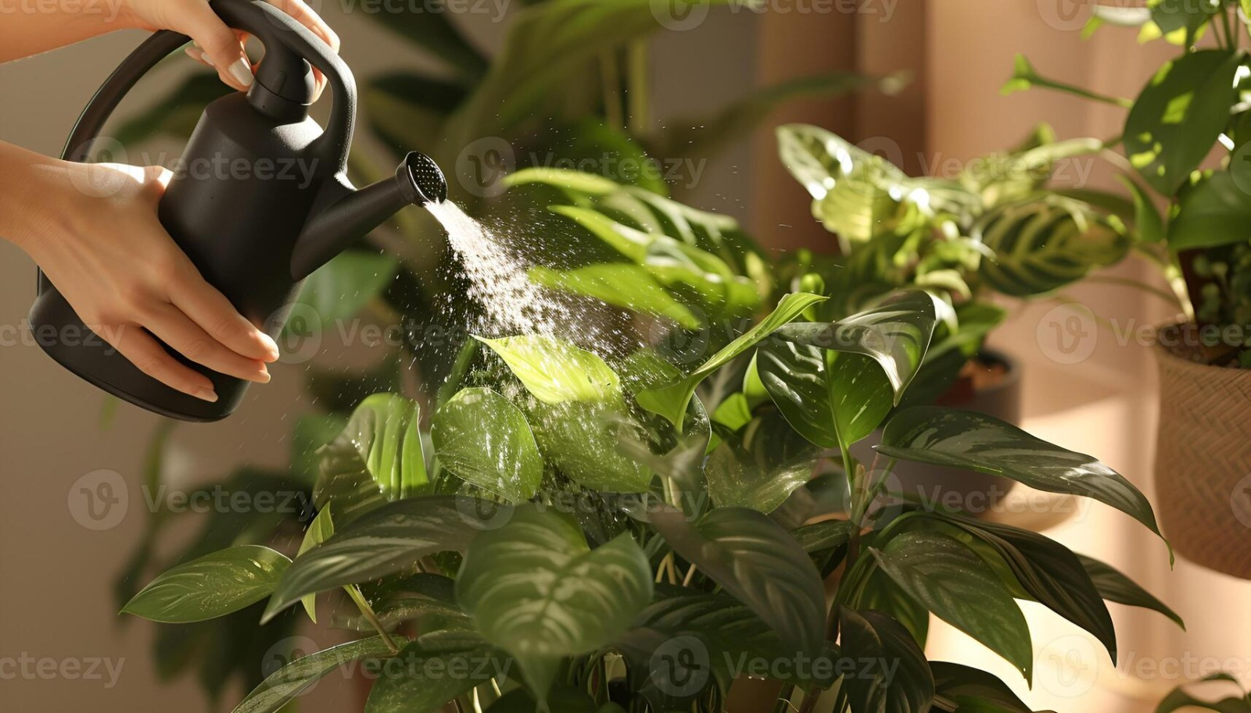
Tools Used :
IBM Watsonx Assistant:
Overview: IBM Watsonx Assistant is an advanced AI-powered chatbot platform designed for building intelligent virtual assistants. It provides natural language processing (NLP) capabilities to understand and respond to user queries effectively.
Features: Multi-channel deployment, easy integration, powerful analytics, and context management to provide personalized and accurate responses.
01
02
03

Slide 5
IBM Cloud Object Storage:
Overview: IBM Cloud Object Storage is a highly scalable and secure cloud storage service for unstructured data.
Features: Reliable data storage, easy data retrieval, built-in data encryption, and cost-effective storage solution. Ideal for storing large datasets, including educational content, user interaction logs, and multimedia resources used by the chatbot.
01
02
03

Slide 6

Solution Overview
WaterBot : An AI chatbot designed to educate communities about water conservation techniques and best practices for maintaining clean water.
Features :
Water-Saving Methods: Practical tips for saving water at home, in the garden, and in the community.
Reducing Water Usage: Strategies for reducing water consumption, including efficient irrigation practices and water-efficient appliances.
Sanitation Awareness: Guidelines on maintaining clean and hygienic environments.
Personalized Advice: Recommendations and advice based on user interaction data.
01
02

Slide 7
How the Model Solves the Problem:
Educational Tool : Provides accurate and timely information on water conservation and sanitation practices. Bridges the knowledge gap and empowers communities to implement sustainable water management practices.
Accessibility : User-friendly interface ensures that individuals of all technological skill levels can interact with WaterBot effectively. Available online via IBM Cloud, making it accessible to a wide audience.
01
02

Slide 8
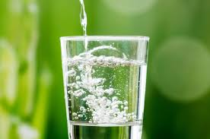
Data Used:
Synthetic Data:
The chatbot uses a repository of pre-defined questions and answers to provide accurate information. Ensures users receive reliable and consistent responses based on best practices and expert knowledge.
01
02
03

Slide 9
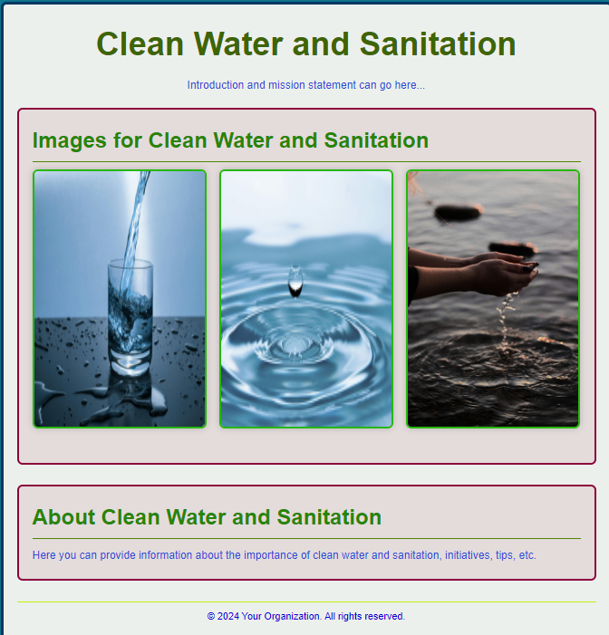
Web Page: Click Here

Slide 10
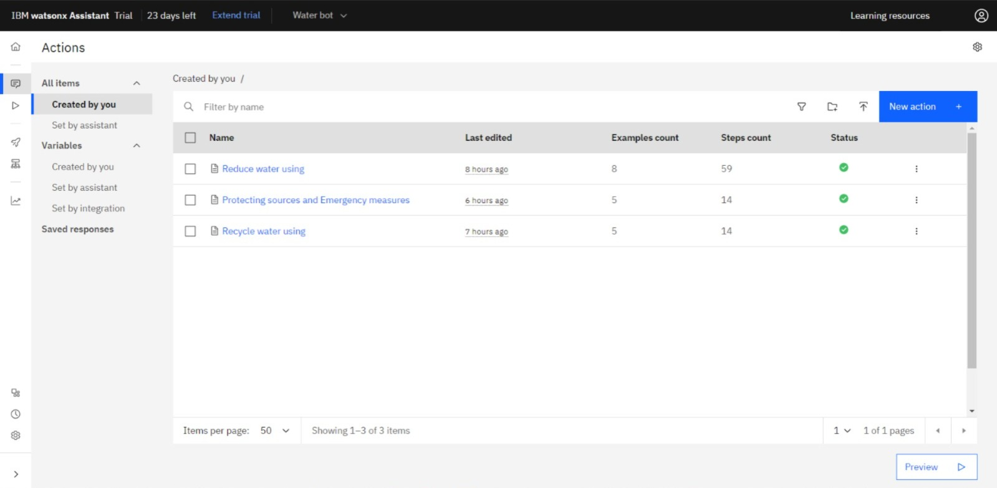
Actions in Waterbot:

Slide 11
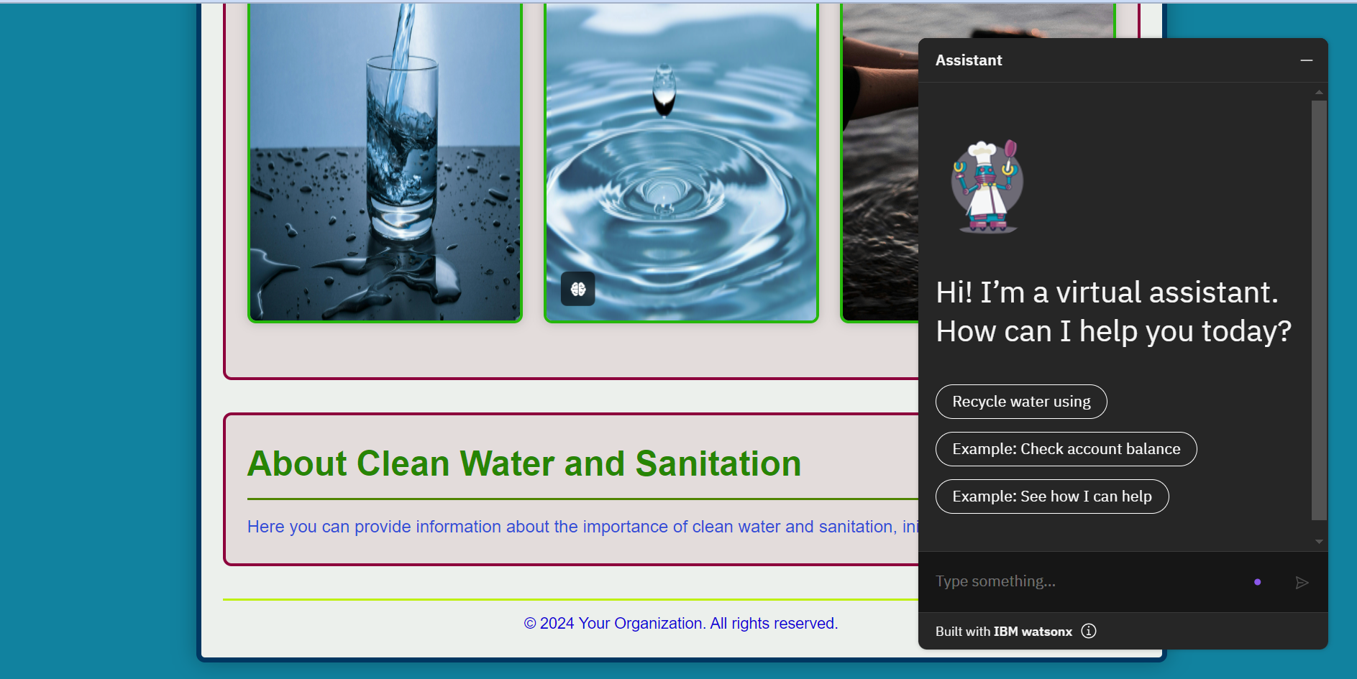
Waterbot Interface :

Slide 12
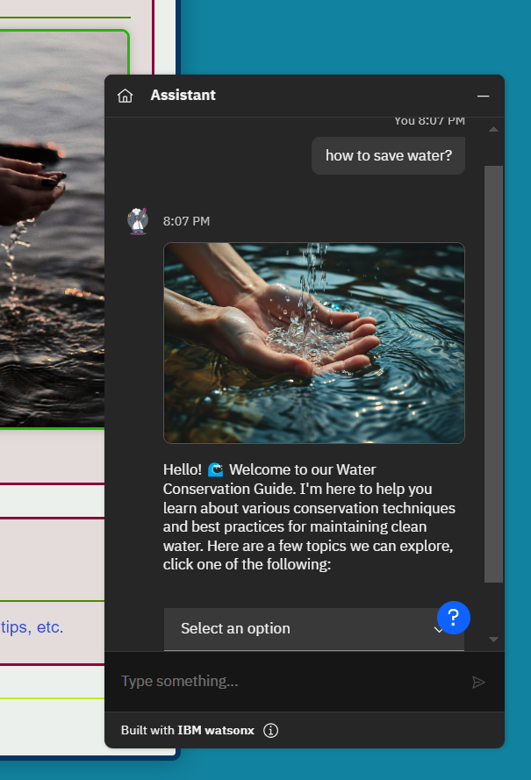
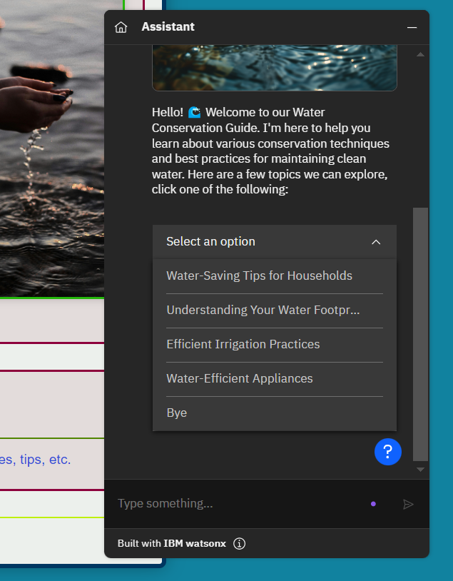
Stage-1:

Slide 13
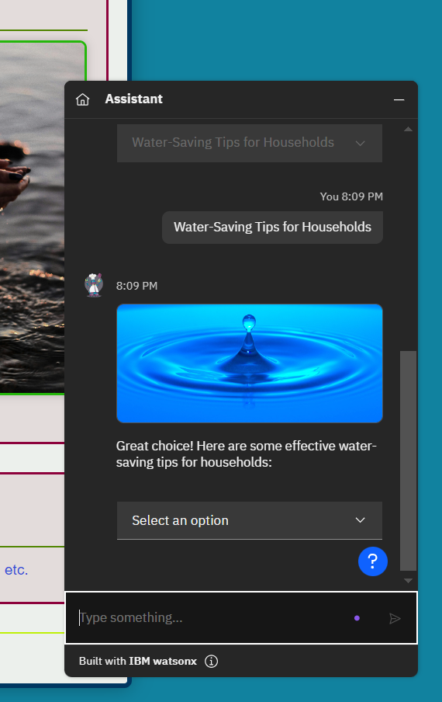
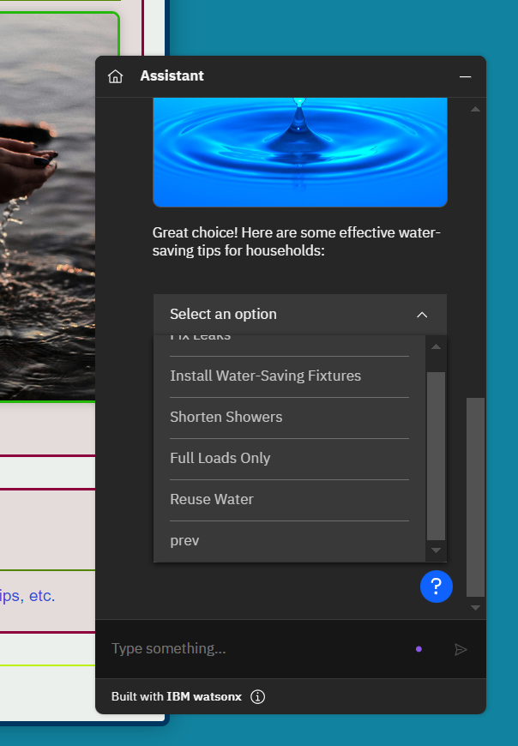
Stage-2:

Slide 14
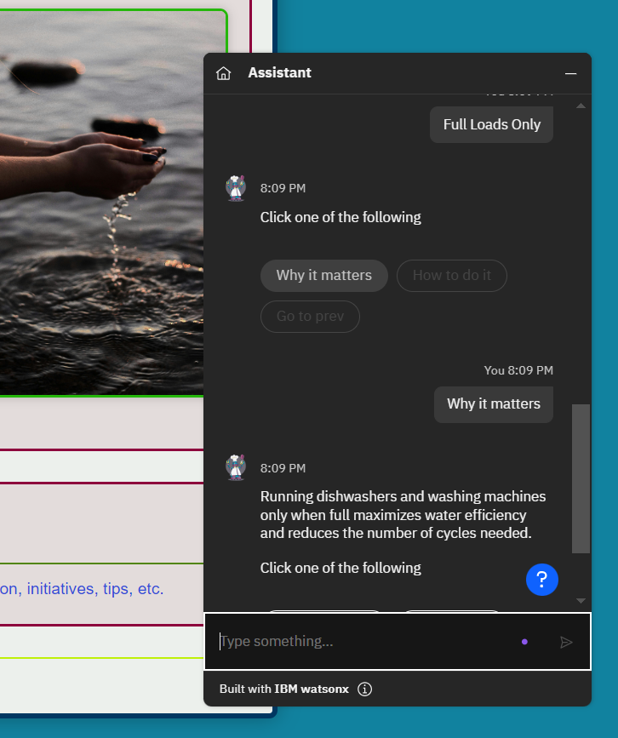
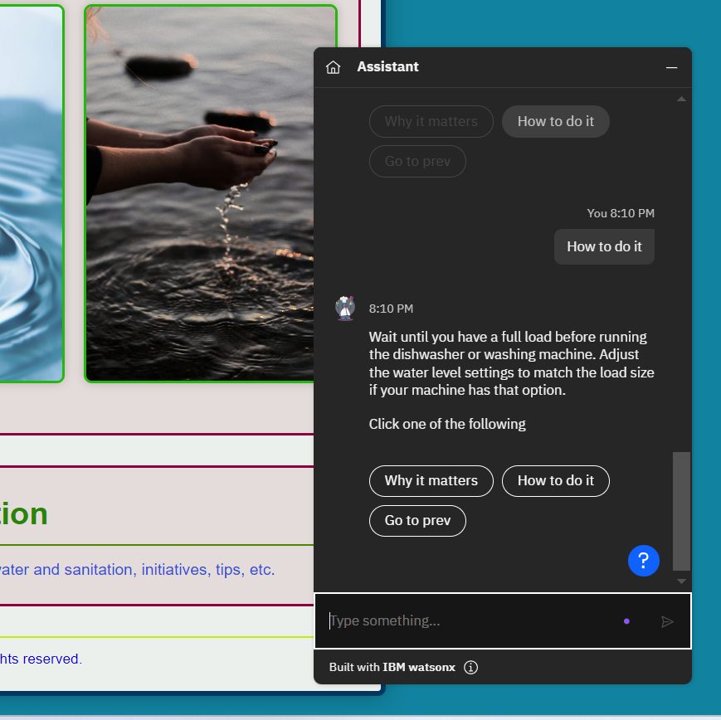
Stage-3:

Slide 15
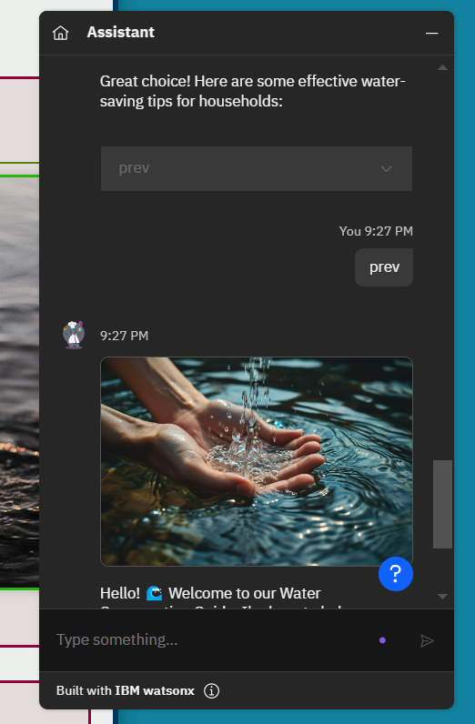
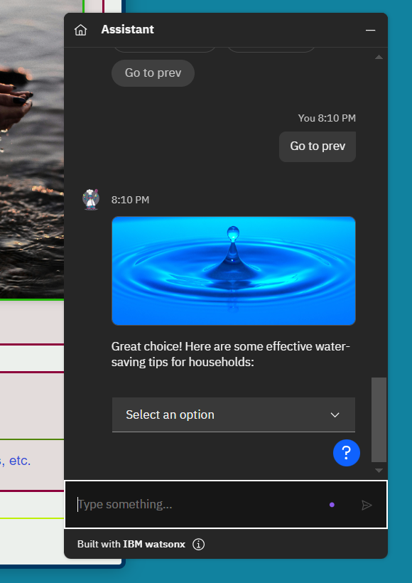
Stage-4:

Slide 16
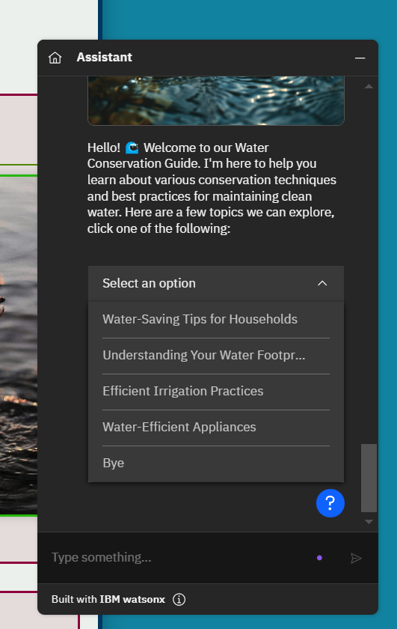
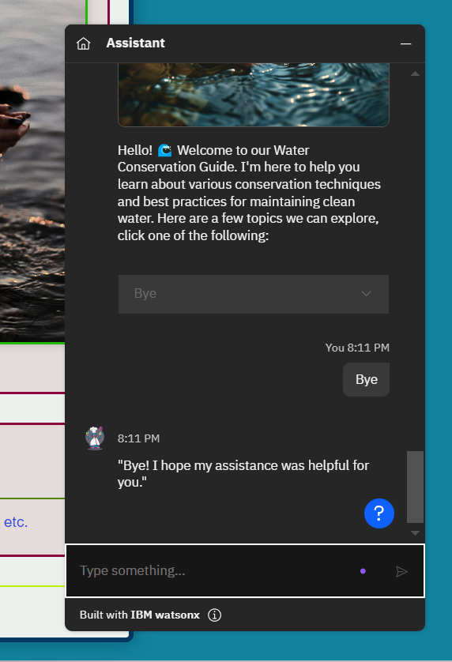
Stage-5:

Slide 17
Conclusion
WaterBot represents a proactive step towards integrating technology with environmental sustainability.
By providing users with the knowledge and tools needed to conserve water and maintain sanitation, WaterBot promotes a healthier environment and contributes to achieving ,Clean Water and Sanitation.
Leveraging IBM Watsonx Assistant and IBM Cloud, this project addresses a critical global challenge, making it a cornerstone in the movement towards a sustainable future.

Slide 18
THANK YOU
Hustle Squad Team Members:
Mandagiri Bhavana - bmandagi@gitam.in
gopisetty venkata vivek - vgopiset@gitam.in
Talanki Bhavya Shree - btalanki@gitam.in
Keerthi Gilla - kgilla@gitam.in
Krishna Varma Vetukuri - kvetukur@gitam.in
Ramesh - rdoddi@gitam.in

